Slide 1
English Writing II
Week 8 PEE paragraph

Slide 2
In today’s lesson
Review of important arguments in the readings (Week 7)
Brainstorming
PEE and close-up reading of samples
In-class writing

Slide 3
Key messages
Gates(2020): In any crisis, leaders have two equally important responsibilities: solve the immediate problem and keep it from happening again.
Kissinger (2020): The US must protect its citizens from disease while starting the urgent work of planning for a new epoch.
Harari (2020): The storm will pass. But the choices we make now could change our lives for years to come.

Slide 4
Gates (2020)
Global health experts have been saying for years that another pandemic whose speed and severity rivaled those of 1918 influenza epidemic was a matter not of if but of when.

Slide 5
Gates (2020)
Many LMIC health systems are already stretched thin, and a pathogen like the coronavirus can quickly overcome them. Poorer countries have little political or economic leverage, given wealthier countries’ natural desire to put their own people first.

Slide 6
Kissinger (2020)
When the Covid-19 pandemic is over, many countries’ institutions will be perceived as having failed. Whether this judgement is objectively fair is irrelevant. The reality is that the world will never be the same after the coronavirus. To argue now about the past only makes it harder to do what has to be done.

Slide 7
Kissinger (2020)
Leaders are dealing with the crisis on a largely national basis, but the virus’s society-dissolving effects do not recognize borders. While the assault on human health will – hopefully – be temporary, the political and economic upheaval it has unleashed could last forever.

Slide 8
Harari (2020)
When people are told the scientific facts, and when people trust public authorities to tell them these facts, citizens can do the right thing even without a Big Brother watching over their shoulders. A self-motivated and well-informed population is usually far more powerful and effective than a policed, ignorant population.

Slide 9
Harari (2020)
The decisions people and governments take in the next few weeks will probably shape the world for years to come. They will shape not just our healthcare systems but also our economy, politics and culture. … When choosing between alternatives, we should ask ourselves not only how to overcome the immediate threat, but also what kind of world we will inhabit once the storm passes.

Slide 10
Harari (2020)
Many short-term emergency measures will become a fixture of life. That is the nature of emergencies. They fast-forward historical processes… Entire countries serve as guinea-pigs in large-scale social experiments. What happens when everybody works from home and communicates only at a distance? What happens when entire schools and universities go online?

Slide 11
How will the pandemic change our lives in the future?
Global cooperation and sharing of data
Widespread surveillance system
…

Slide 12
In-class writing 801 (10 minutes)
More kitchens, less restaurants
Social networking for better?
Parks and other public spaces
Trust in experts and professionals
… (at least three pieces)

Slide 13
PEE Strategy in Writing
A paragraph structure in academic or creative writing
P → Point (a clear and concise thesis)
E → Examples (reliable and recent, supporting examples, quotations, etc.)
E → Explanations (how does the example support your point?)

Slide 14
PEE Strategy in Writing
P → “I think …”
E → “For example…”, “This is shown in … “
E → “This means that…”, “That is the reason why…”

Slide 15
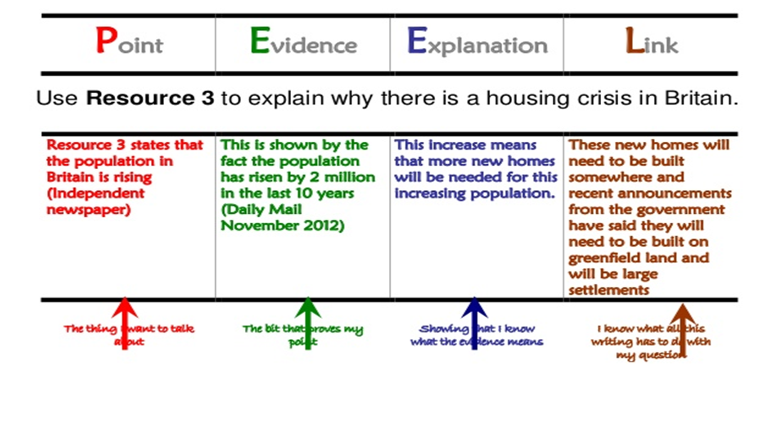
Variations
PEE(E)
PEE+
PEEL

Slide 16
PEE paragraphs in samples
Close-up reading (Week 8).docx

Slide 17
In-class writing 802 (15 minutes)
Choose one of the topics you’ve written for In-class Writing 801
Write a PEE paragraph of around 200 words.

Slide 18
Homework
Explore more ideas for In-class Writing 801
Choose two more ideas and write a PEE paragraph for each of them in the notebook.

